Slide 1

GROUP D
MODEL FINDINGS & RESULTS
ASHMA KHATUN, DAVID ARIZMENDI, JIE CHEN, LI LIN,
MACRIN FRANCIS, QINGXUAN QI, YEE HERN KIMBERLY TAN

Slide 2

Recap
Research Question:
Based on records of previous 311 complaints, can we predict how long an incident will take to resolve?
10/11
10/25
11/15
12/13
Business Understanding
Data
Modeling
Final Presentation
Data Understanding & Preparation
Business context, problem statement, feasibility, and planning
Data selection, joining, cleaning, and exploration
Selected and performed 3 models on Python
Present goals, process, results, and analysis to executives

Slide 3
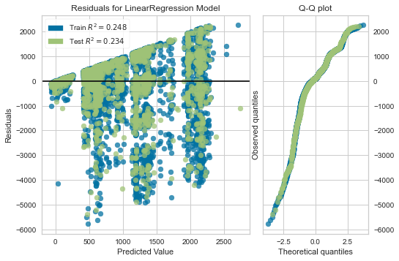
Multiple Linear Regression
What is it? It is a statistical technique that uses several explanatory variables to predict the outcome of a target variable.
Why use it? Provides benchmark before attempting more complex models, simple and low computation time
Fig 1.
Train
Test
Performance Metric | Scores on Test Data
Root Mean Squared Error (RMSE). | 1067.70
R-squared | 0.257
Mean Absolute Error (MAE) | 719.56
RMSE: How close our predictions were to being correct
R-Squared: How close data to fits to line of best fit
MAE: Similar to RMSE, but doesn’t count direction

Slide 4
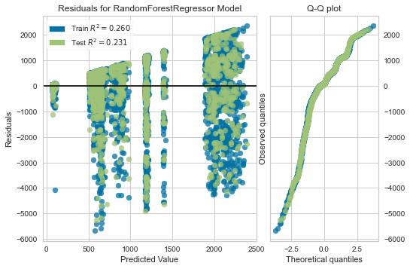
Random Forest Regression
What is it? A random forest trains a large number of decision trees in parallel and aggregates the predictions of the individual trees to form a more accurate result than a single decision tree.
Why use it? It’s less sensitive to outliers
Fig 2.
Train
Test
Performance Metric | Scores on Test Data
RMSE | 1092.8662
R-Squared | 0.2308
MAE | 730.5969
RMSE: How close our predictions were to being correct
R-Squared: How close data to fits to line of best fit
MAE: Similar to RMSE, but doesn’t count direction
Notes:
if our data performed well with the model the residuals graph would have randomly distributed points across the x axis. as you can see in the graph the points are clustered together in straight patterned lines. Also for a good model normal distributed model the q-q plot (this plots against a normal distribution) would present itself as a straight line
there is a high density of points away from the xaxis
extremely prevalent patterns and clusters as we move along the xaxis
these points signify what we have not captured with our prediction
we changed the number of estimators until model performance didn’t improve any further
after running a 5 fold cross validation we went with 100 decision trees to get the lowest rmse score.
The decision tree is an algorithm that divides the models features into branches and predicts an outcome.
The random forest regression takes multiple decision trees and averages them to find a model with the best outcome.
This model is very popular for supervised regression because of it corrects a decision trees tendency to overfitting on the training set.
We also did some tuning with the number of estimators to enhance our model performance.
residuals plot shows the vertical distance between a data point and the line of best fit.
rmse tells us how spread out our residuals are

Slide 5
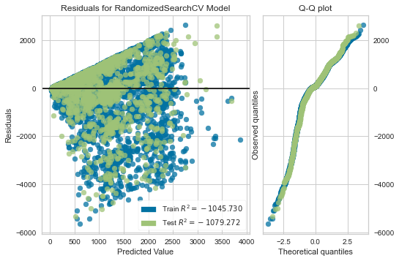
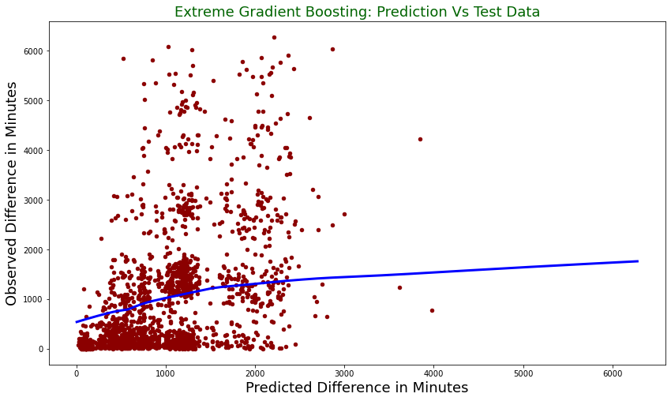
EXtreme Gradient Boosting
What is it? XGBoost is an implementation of gradient boosted decision trees designed for speed and performance.
Why use it? Due to its regularization and generalization capabilities, XGBoost usually performs better than other gradient boosting models.
Performance Metric | Scores on Test Data
RMSE | 1080.06
R-Squared | 0.2487
MAE | 744.1014
Fig 4.
Fig 5.
Train
Test

Slide 6
Model Performance Comparison
Performance Metric on Test Data | Multilinear Regression | XGBoost | Random Forest
Root Mean Squared Error (RMSE) | 1090.86 | 1080.06 | 1092.8662
R-Squared | 0.257 | 0.2487 | 0.2308
Mean Absolute Error (MAE) | 751.4562 | 730.5969 | 744.1014
Why is RMSE so important?
RMSE measures how well the model fits to the data by penalizing larger errors more.
It is the most important criteria, if the goal is prediction. It shows us how close our errors were to being correct.
MAE vs RMSE
MAE is more robust to outliers. It penalizes less for large prediction errors. Regardless, these are still very high scores.
What is R² ?
R- Squared measures the variance the independent variable accounts for in according to changes in the target variable.
Notes:
month
imp 0.018070
VIF 1.0166
category_Illegal Postings
imp 0.016447
VIF 2.4784

Slide 7

Takeaways
Reflection
Unconventional topic
2020 year could be very different
Seasonality
Resource limitation:
Limited machine processing power
Time
Practical Implications
Large RMSE score and low R2 is a good sign that there are no biases with how 311 calls are handle if resolution time is truly unpredictable
Certain areas aren’t getting their cases handled faster than others due to their income levels, amounts of businesses or education)
Notes:
https://medium.com/@skyetetra/so-your-data-science-project-isnt-working-7bf57e3f12f1

Slide 8

Q & A
THANK YOU!

